Slide 1


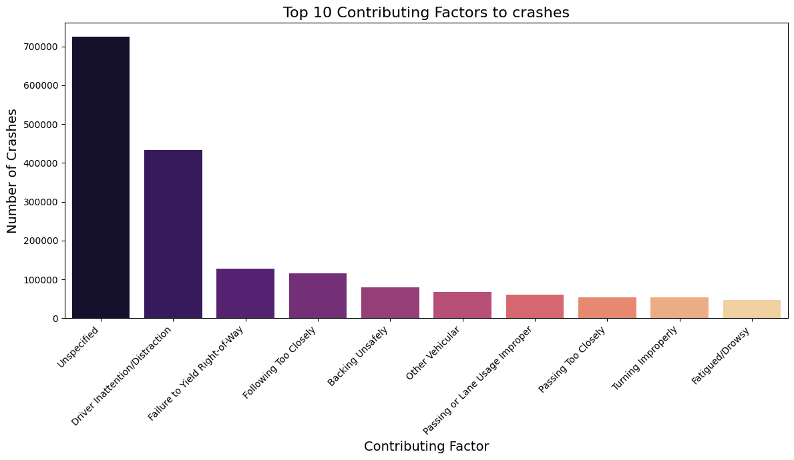
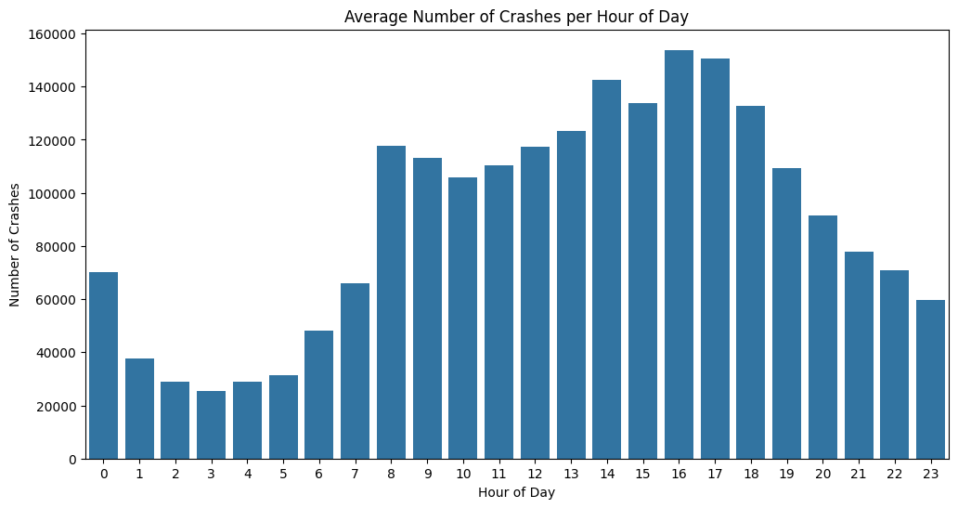
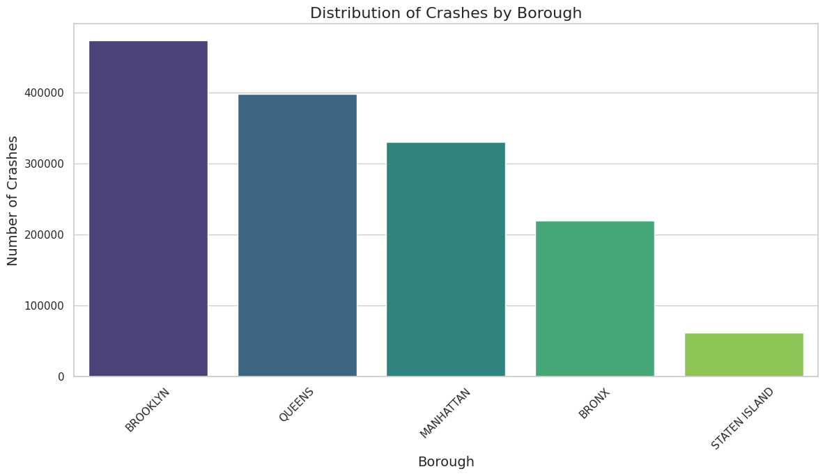
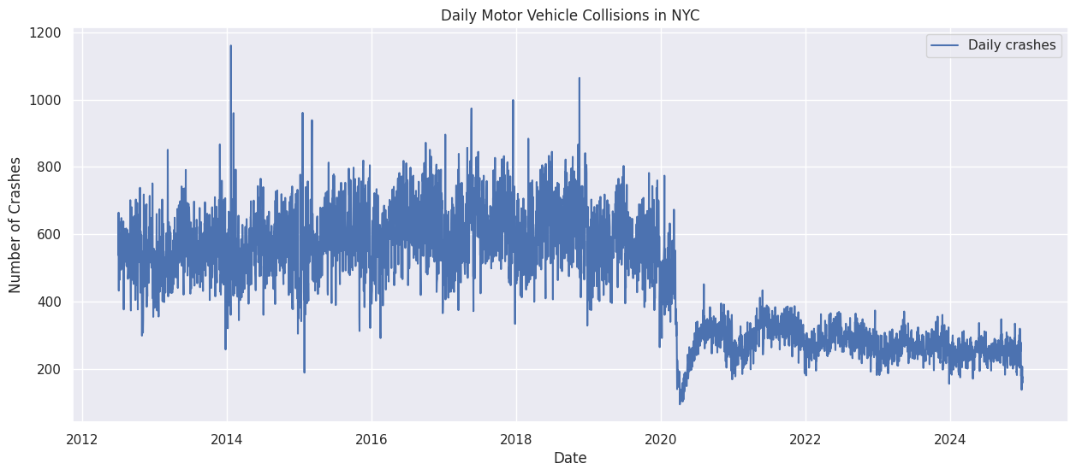
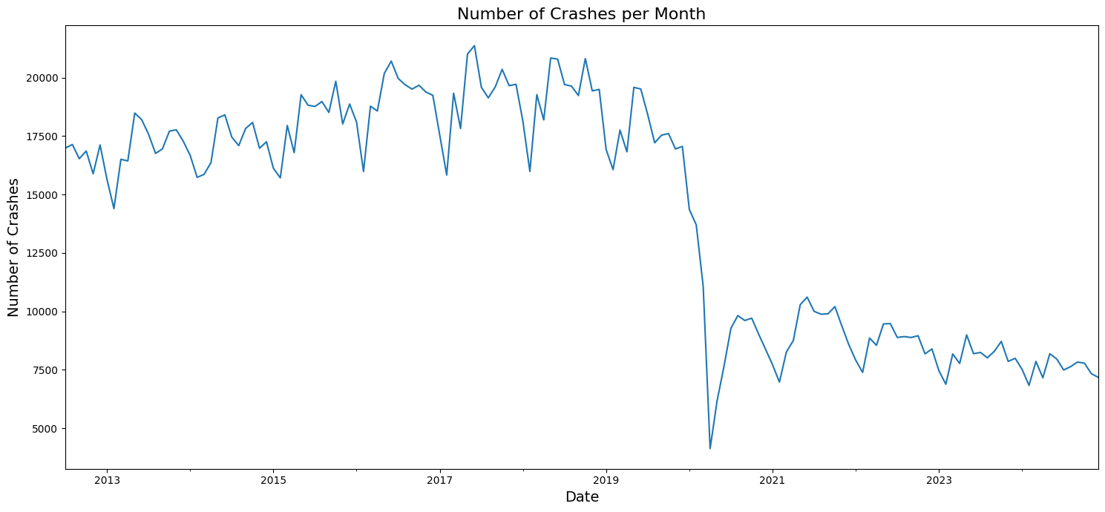
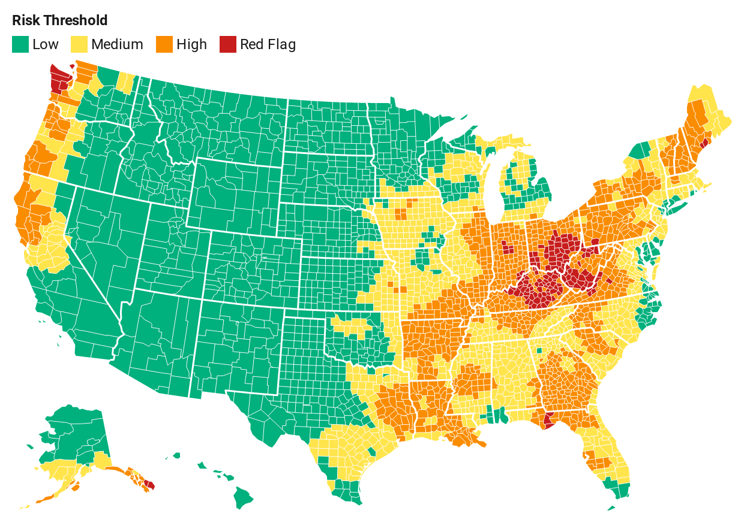
Beyond the Numbers : Analyzing NYC’s Traffic Collision Patterns (2012-2024)
Akshay Kumar Mahto,
U.S Department of Transportation Federal Highway
Administration | Northeast Big Data Innovation Hub
(NEBDHub) | National Student Data Corps(NSDC)
Introduction
NYC’s Traffic Safety Patterns: Our comprehensive analysis of crash data from 2012-2024 reveals striking trends in collision causes, from distracted driving to right-of-way conflicts. By examining over a decade of data , we have identified critical patterns in accident timing and behaviour that could transform how we approach road safety in New York City. This groundbreaking Transportation Data Science project harnesses the power of big data to create safer streets for all New York peoples.
Conclusion
- Temporal patterns show crashes peak during evening rush hours (3-5 PM), with a significant decrease during COVID-19 that led to sustained lower crash levels, indicating lasting changes in traffic patterns.
- -Spatial analysis reveals crash hotspots in high density areas, with Brooklyn recording the highest number of crashes, followed by Queens and Manhattan, though this correlates with population density and brough size.
Figure 1. Top Contributing Factors to crashes
Figure 2. Average Number of crashes per hour of day
Method
Our Analysis of NYC traffic safety combined rigorous data preparation and ethical considerations with advanced time series and geospatial techniques to understand crash patterns. The methodology included cleaning and standardizing the NYC Motor Vehicle Collisions dataset, followed by detailed statistical analysis of crash patterns across time and location. Through interactive heatmaps and visualizations, we identified high-risk areas and temporal trends while considering socioeconomic factors that influence crash patterns.
Figure 5. Distribution of crashes by Borough
Figure 6. Motor Vehicle Collision Trend
Future Direction
- Develop predictive machine learning models that could forecast high-risk periods and locations, enabling proactive deployment of traffic safety resources and emergency response teams.
- Integrate real-time weather data, traffic volume statistics, and road construction information to develop a more comprehensive understanding of crash risk factors and their interactions.
Acknowledgments
I have extend my sincere gratitude to the U.S. Department of Transportation Federal Highway Administration, Northeast Big Data Innovation Hub, National Student Data corps, and NYC open Data for providing the essential resources and datasets that enabled this comprehensive traffic safety analysis.
References
Police Department (NYPD)
NYC Open Data
Figure 2. Number of crashes per Month
Figure 4. Severity Mapping & Heatmap

